Slide 1

Diabetes Prediction
Term Project / DSC 530 / Bellevue University / Summer 2022
Shashi Bhushan

Slide 2
Introduction
Aims to identify diagnostic parameters that can be used to predict diabetes.
Are other variables correlated?
Utilizes data from the National Institute of Diabetes and Digestive and Kidney Diseases, India (Source: Pima Indians Diabetes Database | Kaggle).
Dataset included 8 predictor variables such as number of times pregnant, Glucose levels, Blood Pressure, Skin Thickness, Insulin, BMI, Diabetes pedigree function, and Age. Outcome variable was Boolean (O for diabetes and 1 for non-diabetic).

Slide 3
Selected Variables
Following variables were selected in the analysis based on generally associated diagnostic parameters with existing diabetic cases:
Glucose - Plasma glucose concentration at 2 hours in an oral glucose tolerance test.
BloodPressure - Diastolic blood pressure (mm Hg)
Insulin - 2-Hour serum insulin (mu U/ml)
BMI - Body mass index (weight in kg/(height in m)^2)
Age – Age in years

Slide 4
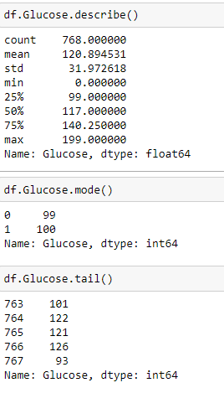
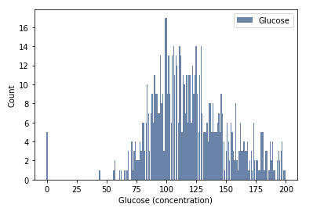
Glucose
Glucose levels below 70 are outliers as glucose levels are typically over 70 for general population.
A check on the frequency of occurrence produced 16 data points out of 768 below 70.

Slide 5
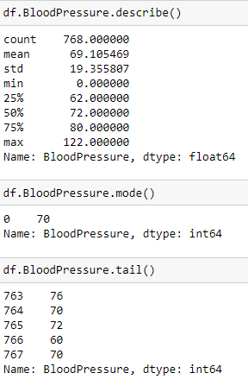
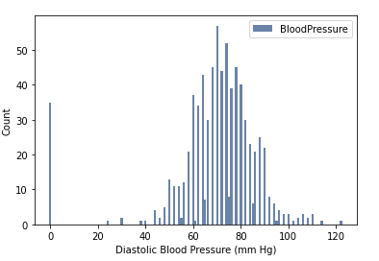
Blood Pressure
Blood Pressure below 50 and over 100 are outliers as these typically are considered too low or too high for diastolic levels.
Latest and smallest 20 numbers indicated single digit frequencies.

Slide 6
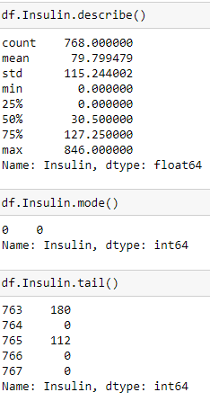
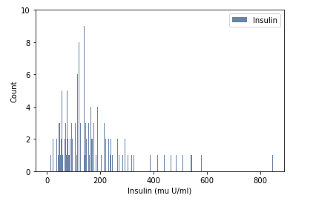
Insulin
Insulin test results less than 50 and higher than 600 were considered outliers as these typically fall under too low and too high for physically active individuals.

Slide 7
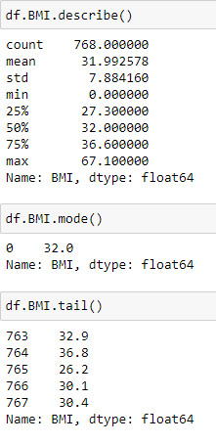
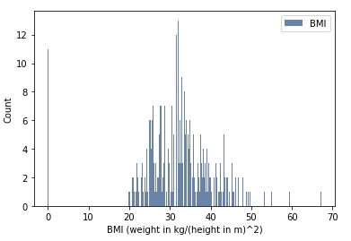
Histogram - BMI
BMI less than 18.2 are outliers and only zero showed as the value which is not a correct representation for BMI,

Slide 8
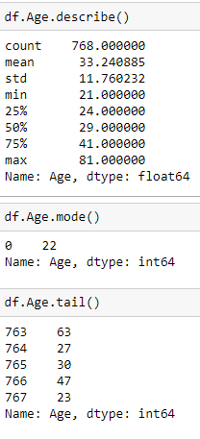
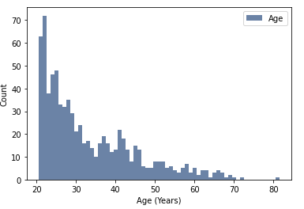
Histogram - Age
No outliers were observed as 20 to 80+ years can have diabetic people.

Slide 9
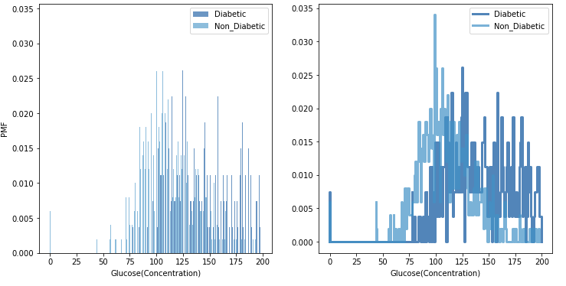
PMF - Glucose

Slide 10
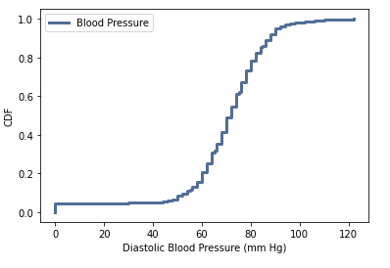
CDF – Blood Pressure
Very few people have their diastolic Blood Pressure below 50. Therefore, it is flat.
About 80% of the people have their diastolic Blood Pressure in the normal range, i.e., 80 mm Hg per recommended limit.
Therefore about 20% of the people are expected to have diabetes.

Slide 11
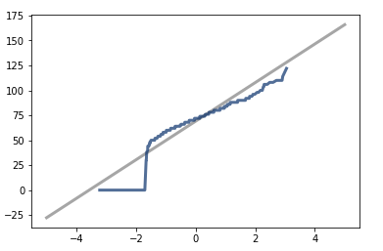
Normal Distribution – Blood Pressure
The normal probability plot shows data is almost normal as it matches the model seen as the gray line

Slide 12
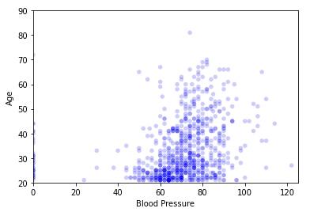
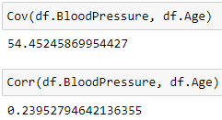
Scatterplot – Blood Pressure / Age
Blood Pressure and Age are +vely correlated but strength of relationship is weak. It can be non-linearly correlated.

Slide 13
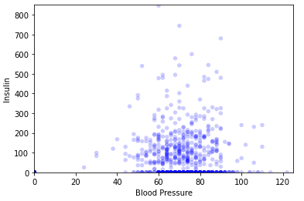
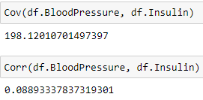
Scatterplot – Insulin / Blood Pressure
Blood Pressure and Insulin levels seem to be +vely correlated but strength of relationship is very less.
It can be non-linearly correlated.

Slide 14
Hypothesis Test
Difference in means for BMI in diabetic and non-diabetic people was tested.
pvalue indicated that we expect to see a difference as big as the observed effect about 0% of the time.
Result is statistically significant.

Slide 15
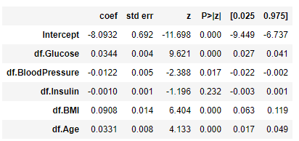
Regression Analysis
Logistical Regression was performed for predicting diabetes with glucose, blood pressure, insulin, BMI, and Age as predictor variables.
As evident from the pvalues Glucose, BloodPressure, BMI, and Age are statistically significant in predicting diabetes if we consider alpha to be 5%.

Slide 16
The End

